Slide 1
Become a Masterchef on Microsoft Azure Automation
Kurt Van Hoecke
Stijn Callebaut

Slide 2
Agenda
Automation
Datacenter automation
Azure Automation as provisioning engine
(Azure) runbook Automation
People, processes and product
Notes:
Stijn

Slide 3
Automation ?
Notes:
KURT

Slide 4
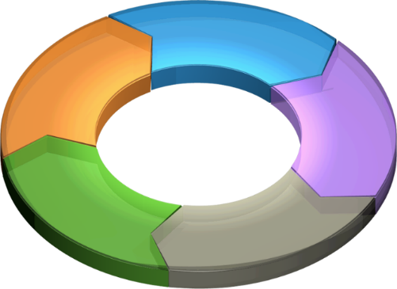
Current Environment
Internal
Outsourced
Processes
Custom Scripts
Internal
Manual
Processes
Vendor-specific Tools
Notes:
Kurt
What is this now all about, we script now already….
Scriptguru’s, isolated knowledge, different tools to manage the same….

Slide 5
Current Environment Issues
Lack of:
Consistency
Compliance
Know how
High customization costs to support
Heterogeneous technological landscape
Internal
Outsourced
Processes
Custom Scripts
Internal
Manual
Processes
Vendor-specific Tools
Lack of:
Standards
Unified Management
Consolidated Error Handling
Lack of:
Consistency
Compliance
Notes:
KURT
The biggest challenge with IT process automation isn’t the technology­—it’s the interface with the business and business processes. That challenge is also fundamental to other business and IT initiatives. There’s no doubt that automating tasks is one of the key elements to realizing the benefits of both private and public clouds. This is the primary challenge facing IT professionals in the shift to cloud computing.

Slide 6
IT Process Automation Elements
Standardization of the environment
Common toolset
System and Processes automation
Automation Team- DevOps?
Notes:
KURT
Centralize knowledge, approach, processes, single pane of glass, …

Slide 7
Datacenter automation
Notes:
STIJN - AUDIENCE
What comes to mind when we talk datacenter lifecycle?
Monitoring
Storage management
Patch Tuesday
Server provisioning
Deprovisioning

Slide 8
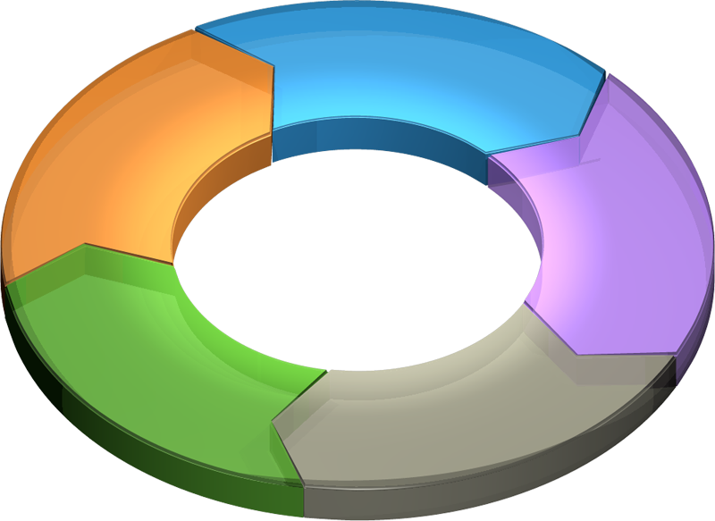
Lifecycle of the datacenter
Service Management, Compliance, and Reporting
Service catalog
Reporting
Change management
Capacity management
Cloud Provisioning and Deprovisioning
Infrastructure
Servers
Virtual machines
Applications and services
Security and Disaster Recovery
Infrastructure
Servers
Virtual machines
Applications and services
Monitoring and Remediation
Infrastructure
Servers
Virtual machines
Applications and services
Maintenance and Patching
Infrastructure
Servers
Virtual machines
Applications and services
Notes:
KURT
Different area’sin the lifecycle of the datacenter
Focus on that one point where we provide demo’s around
Possible automation targets
Switches and routers
Storage
Servers
Active directory
Office 365
Google Apps
Amazon web services
Salesforce.com
…
Any (Cloud) service that provides a PS Module or API!!

Slide 9
Azure Automation as provisioning engine
Notes:
Kurt

Slide 10








Azure Automation
All
ITEMS
WEBSITE CLOUD
12
CMDB
VIRTUAL MACHINE CLOUDS
12
Automation
SQL SERVER
9
VM provisioning
User Creation
Add additional service capacity
Ticketing
MYSQL SERVERS
0
Notifications
0
PLANS
12
Billing
USER ACCOUNTS
4
AUTOMATION
8
Management
Systems
Notes:
KURT
What is SMA?
Process automation tool
Built on foundation of PowerShell Workflows
Native Integration with Windows Azure Pack
First a quick view (WAP or Azure) where you can find the SMA interface. Short GUI overview where this automation is managed
Quick overview of the interface
WAP
GridPRO
SCSM

Slide 11
Built on PowerShell workflow
Centralized store
Highly Available
PowerShell Workflow
Use Windows PowerShell syntax
Running a single task to manage complex, end-to-end processes
Automated failure recovery
Connection and activity retries
Multi-device management
Historical Analysis
View runbook used for all jobs
Reporting through Excel PowerPivot for ROI
Historical view of runbook jobs
SQL Server clustering / always on
Odata Web service to submit / retrieve status
Runbook servers to process jobs
Scheduling
Runbooks (draft / published versioning)
Modules
Global connection for runbooks
Global variable
Credentials / certificates
PowerShell Workflow
Centralized store
Service Management Automation
Highly Available
Historical Analysis
Notes:
STIJN
First a quick view (WAP or Azure)
Windows PowerShell workflows are designed for scenarios where these attributes are required
• Long-running activities.
• Repeatable activities.
• Frequently executed activities.
• Running activities in parallel across one or more machines.
• Interruptible activities that can be stopped and re-started, which includes surviving a reboot of the system against which the workflow is executing where you can find the SMA interface. Short GUI overview where this automation is managed
What is PowerShell Workflow?
Introduced with PowerShell 3.0
Common PowerShell syntax
Utilizes Windows Workflow Foundation (WF)

Slide 12
Demo
What? → Overview of the interface
Built-in automation? → PS Modules in Azure Automation
Integration? → Procedure import PS module
Notes:
Kurt

Slide 13
… and the Windows Azure Portal
Azure Portal provides a GUI to Azure Automation
Azure PowerShell module support
Tight interaction with Azure
No other communication yet ;-)
Notes:
Kurt

Slide 14
(Azure) runbook Automation
Notes:
Kurt-Stijn

Slide 15
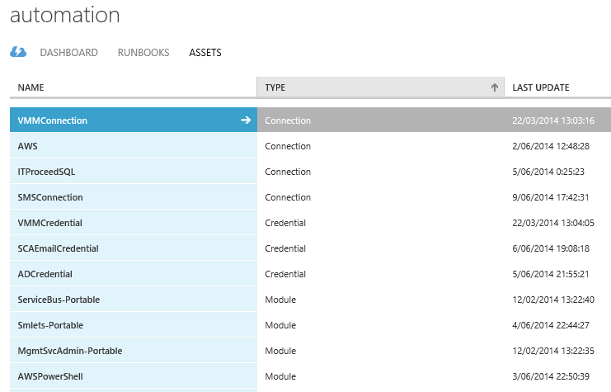
Azure Automation Assets
Globally available combination of settings
Connections
Credentials
Schedules
Variables
Notes:
STIJN
SIMILAR TO ORCHESTRATOR
Connections: connection information for external systems
Credentials: PSCredential or Certificate
Schedules: Runbook execution schedule
Variables: Available to all Runbooks
This is quite similar to the items in Orchestrator.
Remember menu > options for the connections
Variables, schedules,....

Slide 16
Azure Automation capabilities
Inlinescript
Parallel execution (Parallel / Foreach -Parallel)
Nesting runbooks
Snapshots (Checkpoint-workflow / -PSPersist)
Pauze/resume (suspend-workflow / resume-workflow)
Notes:
STIJN
BENEFIT OVER USING ORCHESTRATOR!!!!
Inlinescript:
Execute PowerShell cmdlets within a workflow
Creates a PowerShell session in the background, cf PowerShell remoting
Workflow variables are not visible. ($using or argumentlist )
Parallel:
PowerShell has the capability to execute actions in parallel.
Foreach –parallel {}
Parallel {}
Nesting:
Invoke inline start runbook by name = All runbooks are compiled into 1 job → Synchronous execution
Start-SmaRunbook = start using cmdlet, starts a 2nd job → asynchronous execution
Snapshot:
Checkpoint-workflow
-PSPersist $true parameter of activity
$PSPersistPreference = $true variable
Suspend-workflow
Pauze/resume:
Suspend-workflow = checkpoint and suspend
Suspend-smaJob = suspend at next checkpoint
WAPGui = suspend at next checkpoint

Slide 17
DEMO: Stop/start VM’s
Azure portal
Automation schedule
Vms Stopped
VMs Started
Notification
Azure Runbook
Notes:
KURT -
1. Go to WAP admin site
2. Click Automation
3. Click Runbooks
4. Click CreateUser RB
5. Explain the runbook
6. Search for send-O365Message
7. Explain runbook
8.Execute
Show email in outlook
Show data SQL HR database

Slide 18
DEMO: Backup SQL
Automation input
Database name
SMA runbook
PowerShell runbook
…
Azure Cloud service
Backup SQL database to blob
Notes:
1. Go to WAP admin site
2. Click Automation
3. Click Runbooks
4. Ask for a phonenumber
5. Fill in password ITProceed*
6. Start the runbook
7. In the mean time, explain the runbook
8. Calls another runbook
9. Go to Jobs
10. Job provides some output
11. User receives an SMS

Slide 19
Administration, Authoring and Execution
Azure Portal or PowerShell ISE
Runbook Tags
Different states
Flexible execution methods
Job = instance of executed Runbook
Notes:
STIJN
Potential Runbook states (Draft, Published, In-Edit)

Slide 20
DEMO: Backup VM’s
Automation input
VM name
SMA runbook
PowerShell runbook
…
Azure Cloud service
Backup VM disks to blob
Notes:
1. Go to WAP admin site
2. Click Automation
3. Click Runbooks
4. Ask for a phonenumber
5. Fill in password ITProceed*
6. Start the runbook
7. In the mean time, explain the runbook
8. Calls another runbook
9. Go to Jobs
10. Job provides some output
11. User receives an SMS

Slide 21
Key Takeways
Think PowerShell
Azure/SMA – The hybrid automation solution
Azure Automation/SMA is a fast moving service in WAP and Azure
Think about the three musketeers - People, processes, product (and PowerShell)!
Notes:
Stijn
Kurt
Stijn
Kurt → De 3 musketiers waren eigenlijk met 4 ;-)
(per topic)

Slide 22
People, processes and product
Notes:
Kurt

Slide 23
Processes in automation
Service offering
Request offerings
Work item used to identify and classify standard IT services
Offering created by IT service provider that consumers request using the service catalog
Contains one or more request offerings
Based on a template
Templates
Minimize data entry by providing default values
The service catalog
Standardize processes
GRIDPRO:
WAP – Requests
SMA Runbooks - SCSM
SCSM:
Create Service/Request Offering
WAP:
Create request in WAP portal
SCSM Process flow
SMA provisioning of the request

Slide 24
DEMO: Processes in automation
SCSM Process
SR work item
Approvals
Calls SMA Runbook
Automation input
WAP portal
Password
Phone number
…
SMA runbook
PowerShell runbook
…
Azure Cloud service
- VM provisioning
Send notification

Slide 25

Bedankt! Vragen?
GO BELGIUM

